Slide 2
Regular consumption of alcohol and risk of HIV infection in transgender women in Fortaleza, Northeast Brazil
Sandra Brignol
@sandrabrignol
Share your thoughts on this presentation with #IAS2019

Slide 3
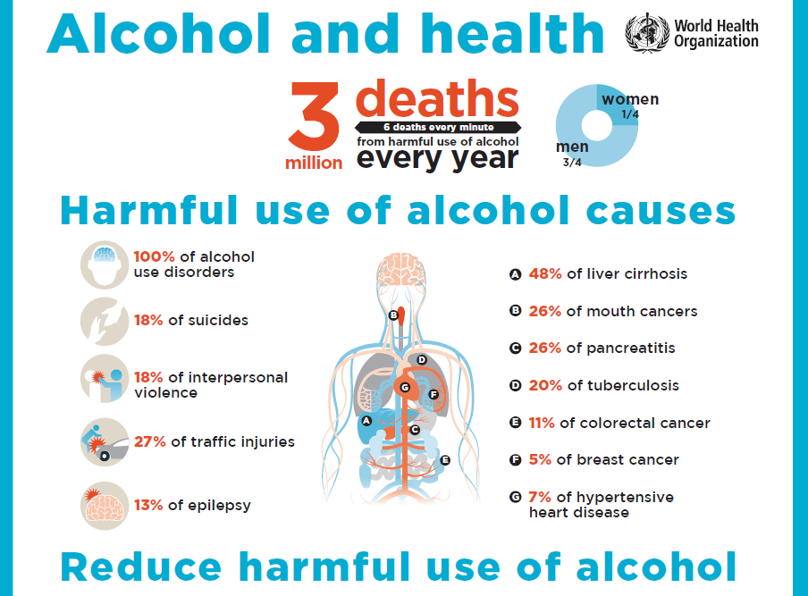
3.Background: consumption of alcohol and risk of HIV infection
We know that harmful use of alcohol (HUA) is a public health problem¹
World Health Organization (WHO)
“Harmful alcohol use” is :
People 18 years old or older people who drink alcohol once or more times a week¹.
Average world- 195 coubtries:
two glasses of wine (300 ml
This pattern consumption:
The causal relationships between HUA and HIV^{2,3}
I ncreases the risk of HIV transmission,
Interferes in treatment - (adherence and treatment efficacy)
Unprotected sex, etc
Sexual Violence

Slide 4
4.RAC in transgender women population
1.RAC in world
Los Angeles e Chicago (EUA): 88% (sex workers)
São Francisco (EUA)¹⁴: 58% and 69%
EUA¹⁵ (2017): 21.5%
2.RAC in Brazil^{7,8}
In general population: 24%
Transgender Women: 74.2% in Fortaleza city (2016)
Uberlandia- MG(2013): 85% (sex workers)
The vulnerability of transgender women in Brazil is very large^{9,10}
Violence, stigma and discrimination are systematic (every day)
Violation of Human Rights
Sexual work is common in the face of social exclusion
Increases the problem of alcohol in recent literature review^{2,3}.

Slide 5
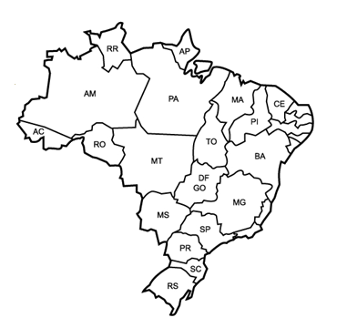
5. Methods: Divas Research – 12 cities in Brazil (2015/2017)
Total sample size Brazil: 2,846 transgender women
These results are a part of the Divas survey
Belém
Fortaleza city:
Data collect: between October 2016 and July 2017 (RDS study)*
Sample size: 348 transgender women
Manaus
Fortaleza
Recife
Salvador
Fortaleza is the third largest city in northeastern Brazil and important tourist city of the country.
Brasília
We defined RAC = Harmful alcohol use (WHO)
Belo Horizonte
Campo Grande
Rio de Janeiro
São Paulo
Curitiba
*Others informations:
Bastos, Francisco I., et al. "HIV, HCV, HBV, and syphilis among transgender women from Brazil: assessing different methods to adjust infection rates of a hard-to-reach, sparse population." Medicine 97.1 Suppl (2018).
Porto Alegre

Slide 6
5. Background (small): HIV infection
HIV in Brazil^{4,5,6}
In general population: 0.6%
Transgender women: 31.2% (18.8-43.6)CI 95%
HIV in othes countries^{7,8}
Transgender women
Baral et al (2013): all contries 19.1% (17.4-20.7)CI 95%
Low-income and middle-income countries 17.7% (15·6-19·8) 95% CI
Poteat et al (2016) USA : 40%

Slide 7
6. Results
RAC – regular alcohol consumption:
RDS recruitment chain
1. The average consumption of alcohol in the last three months was
44.8% (37.0-52.7) CI 95% (RDS II)
HIV+: 20.5% (11.0-30.1) CI 95%
RAC and HIV+: 29.4% (18.6%-40.2%)
2. Factors associated with RAC: OR (CI 95%)
HIV: OR = 2.1 (1.04-4.2)
Smoking Tobacco: OR = 3.0 (1.7-5.3)
Use of crack/cocaine: OR = 4,5 (2,1-9,5)

Slide 8
7. Results*: profile of transgender women (RAC)
Vulnerability
Age
18 to 24: 45.3%
24 to 64: 54.7%
Don’t Know PEP: 82.0%
Monthly income**:
up to U$ 238,5: 70.1%
U$ 238.5 to U$ 954: 27.6%
Don’t Know PrEP: 93.8%
informal employment: 90.0%
Tobacco: 73.1%
elementary School : 64.1%
high school: 33.3%
higher education: 2.3%
Marijuana: 40.5%
Crack/cocaine: 41.6%
Black: 84.41%
Sex worker: 37.6%
* Estimate to RDS II
**approximate value

Slide 9
8. Conclusions
The prevalence RAC in TW is double compared to Brazilian general population
And others populations transgender women- USA
We found an association between RAC and HIV … increases the risk of HIV infection
The association of RAC, Cocaine and/or Crack indicates urgent interventions to reduce health problems (mental and generate health)
We found a scenario of social vulnerability among participants (stigma and violence systematic in their life)
We know: recent results in literature and others present in IAS 2019
Message:
Reducing stigma, discrimination, and violence in the transgender women remains a major challenge in Brazil

Slide 10
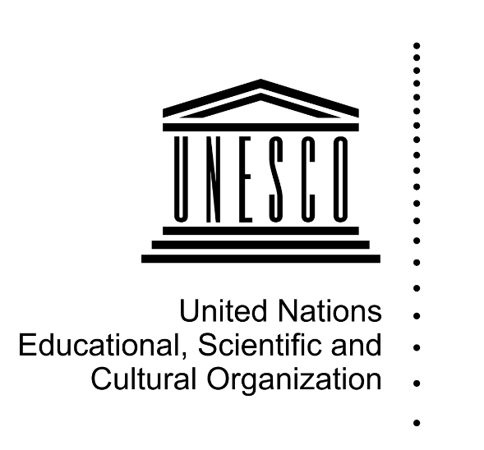
Thanks
Department of diseases of chronic conditions and sexually transmitted infections
Contact: email: sandrabrignol@id.uff.br

Slide 11
9. References
World Health Organization. Global status report on alcohol and health 2018. Geneva; 2018. Licence: CC BY-NC-SA 3.0 IGO.
Baliunas D, Rehm J, Irving H, Shuper P (2010). Alcohol consumption and risk of incident human immunodeficiency virus infection: a meta-analysis. Int J Public Health. 55(3):159–66.
Woolf-King SE, Maisto SA (2011). Alcohol use and high-risk sexual behavior in Sub-Saharan Africa: a narrative review. Arch Sex Behav. 40(1):17–42.
Baral SD, Poteat T, Strömdahl S, Wirtz AL, Guadamuz TE, Beyrer C. Worldwide burden of HIV in transgender women: a systematic review and meta-analysis. Lancet Infect Dis. 2013 Mar;13(3):214-22.
Brasil . Ministério da Saúde. Boletim Epidemiológico.
Grinsztejn B, Jalil EM, Monteiro L, Velasque L, Moreira RI, Garcia AC, Castro CV, Krüger A, Luz PM, Liu AY, McFarland W, Buchbinder S, Veloso VG, Wilson EC; Transcender Study Team. Unveiling of HIV dynamics among transgender women: a respondent-driven sampling study in Rio de Janeiro, Brazil. Lancet HIV. 2017 Apr;4(4):e169-e176.
B aral SD, Poteat T, Strömdahl S, Wirtz AL, Guadamuz TE, Beyrer C. Worldwide burden of HIV in transgender women: a systematic review and meta-analysis. Lancet Infect Dis. 2013 Mar;13(3):214-22
Brasil. Ministério da Saúde. Pesquisa Nacional de Saúde, 2013
Kerr-Corrêa, F., Júnior, P., Leal, F. M., Martins, T. A., Costa, D. L. D. C., Macena, R. H. M., ... & Kerr, L. R. F. S. Hazardous alcohol use among transwomen in a Brazilian city. Cadernos de Saúde Publica, 33(3). 2017
Magno L, Dourado I, Silva LAV. Estigma e resistência entre travestis e mulheres transexuais em Salvador, Bahia, Brasil. Cad Saúde Pública 2018; 34:e00135917.
Magno, Laio, et al. "Estigma e discriminação relacionados à identidade de gênero e à vulnerabilidade ao HIV/aids entre mulheres transgênero: revisão sistemática." Cadernos de Saúde Pública 35 (2019): e00112718.
Bastos, Francisco I., et al. "HIV, HCV, HBV, and syphilis among transgender women from Brazil: assessing different methods to adjust infection rates of a hard-to-reach, sparse population." Medicine 97.1 Suppl (2018).
Pan American Health Organization and Joint United Nations Programme on HIV/AIDS. HIV Prevention in the Spotlight: An Analysis from the Perspective of the Health Sector in Latin America and the Caribbean, 2017. Washington, D.C.: PAHO, UNAIDS; 2017.
Transgender Youth Substance Use Disparities: Results From a Population-Based Sample.Day JK, Fish JN, Perez-Brumer A, Hatzenbuehler ML, Russell ST.J Adolesc Health. 2017 Dec; 61(6):729-735. Epub 2017 Sep 21.
Gonzalez CA, Gallego JD, Bockting WO.Demographic Characteristics, Components of Sexuality and Gender, and Minority Stress and Their Associations to Excessive Alcohol, Cannabis, and Illicit (Noncannabis) Drug Use Among a Large Sample of Transgender People in the United States. J Prim Prev. 2017 Aug;38(4):419-445. doi: 10.1007/s10935-017-0469-4.

